Slide 1
IoT Devfest 01/25/2020
SEWABLE CIRCUITS:
MAKING A WEARABLE WEBTHING

Slide 2

ROADMAP
Who Am I?
Your Toolkit
MicroBlocks
Mozilla WebThings
Sewing Time
@elginskye

Slide 3
WHO AM I?
@elginskye

Slide 4
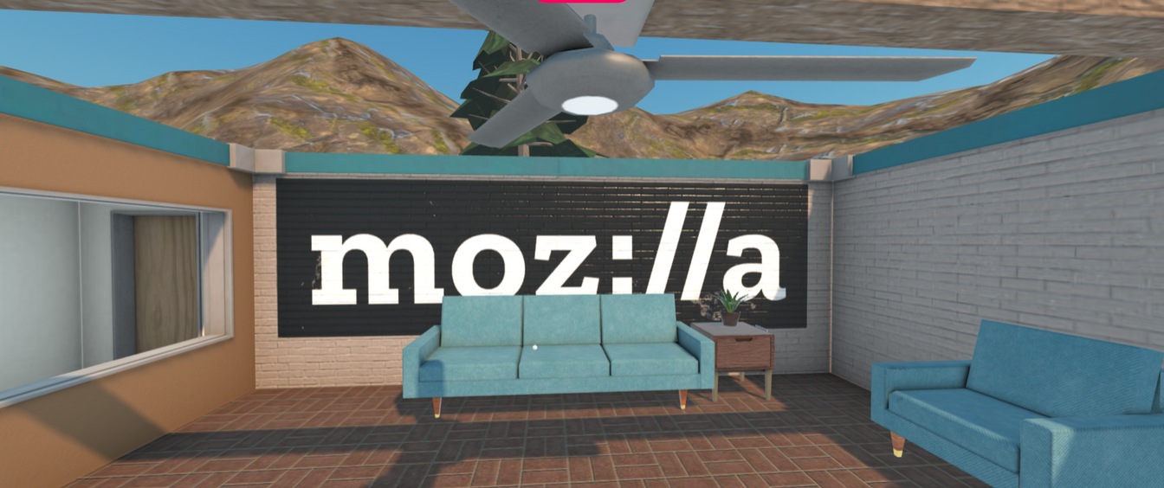
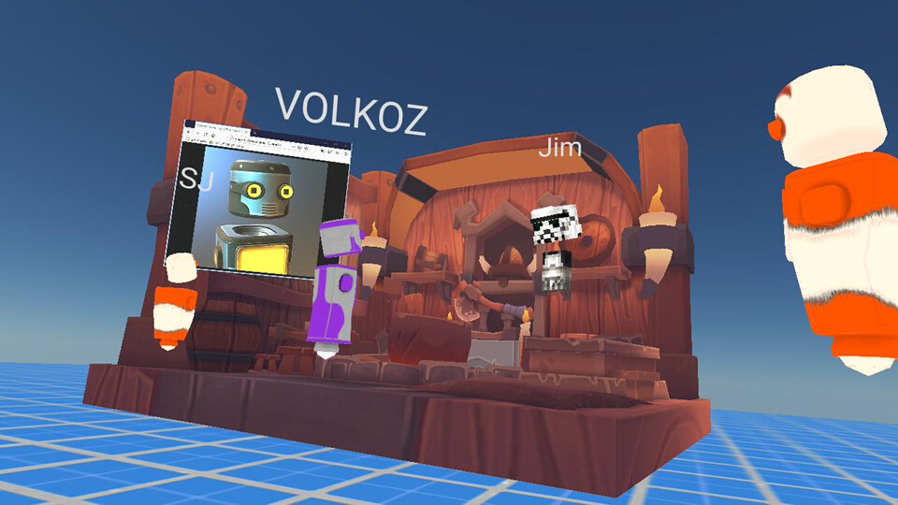
HI, I'M
ELGIN-SKYE
MOZILLA HUBS
Community & Events Manager
SIMON FRASER UNIVERSITY
MSc Interactive Arts + Technology
MOZILLA TECH SPEAKER
@elginskye

Slide 5
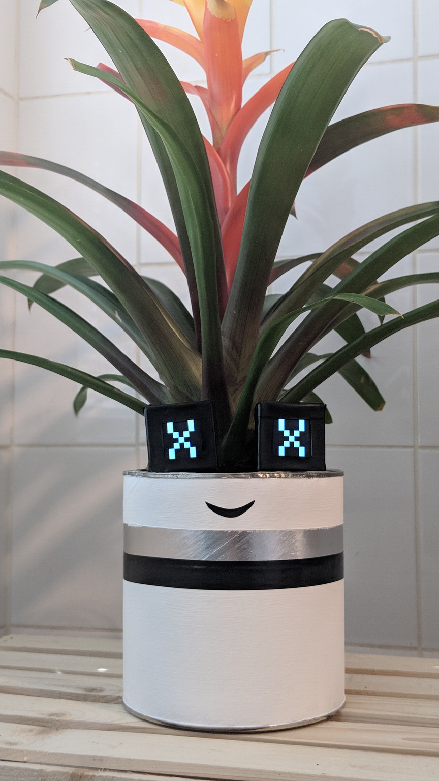
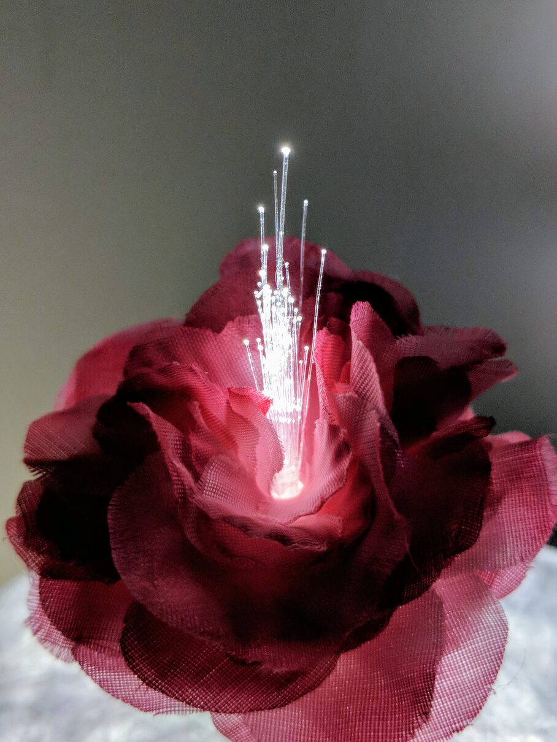
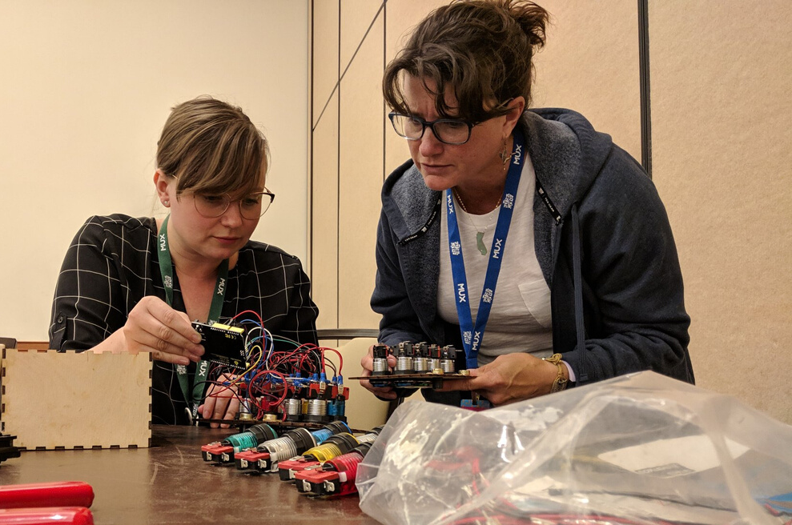
I LIKE TO MAKE STUFF
@elginskye

Slide 6
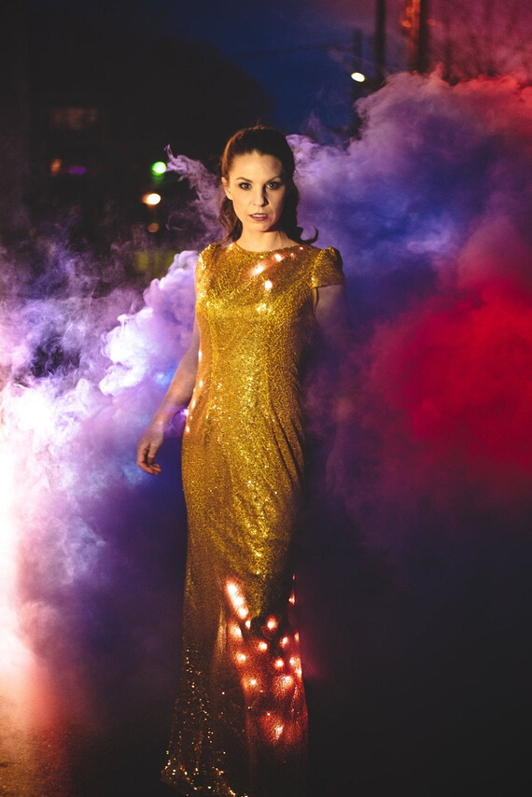
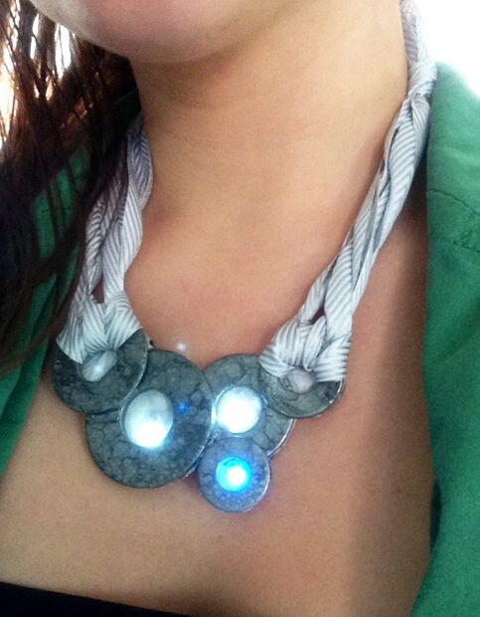
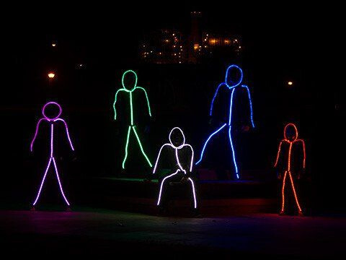
WEARABLE TECH
Photo - Lumen Couture
Photo - Instructables
Photo - Make Fashion
@elginskye

Slide 7
YOUR
TOOLKIT
@elginskye

Slide 8
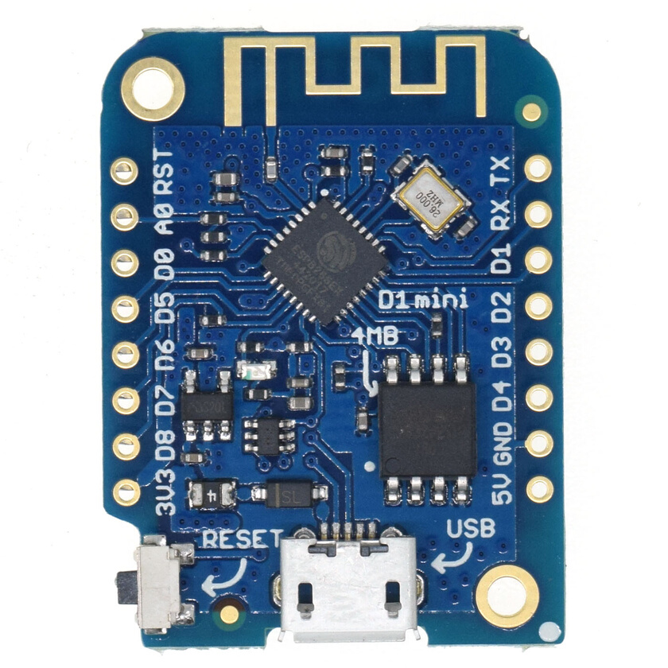
WEMOS
ESP8266
Wifi Enabled
Tiny
Cheap!
@elginskye

Slide 9
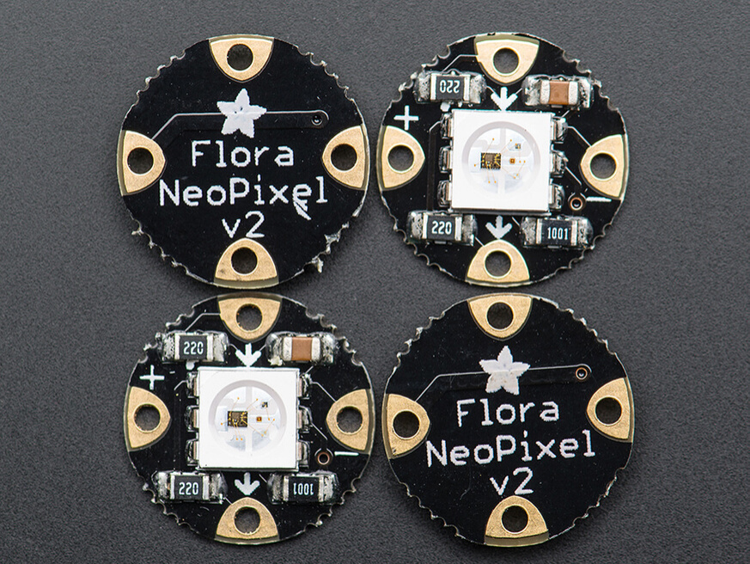
NEOPIXEL
RGB
Sewable
@elginskye

Slide 10
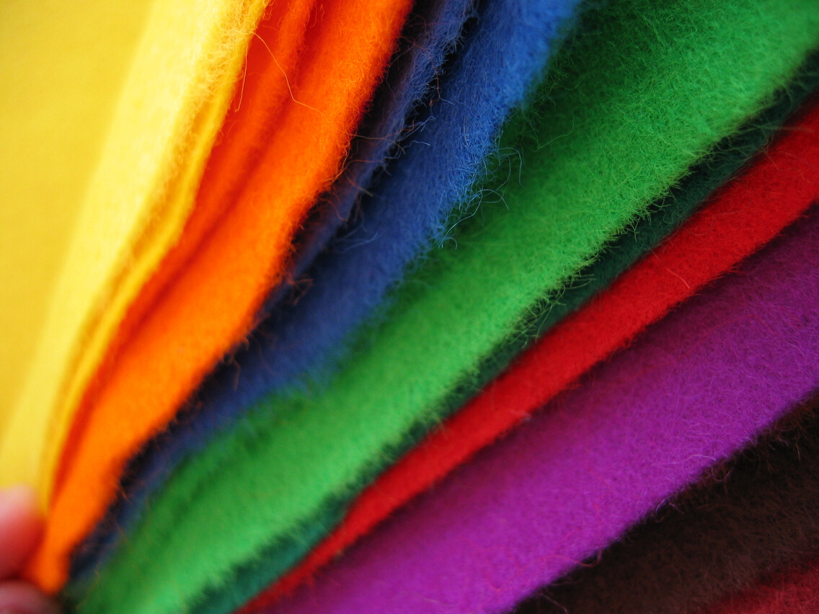
FELT
@elginskye

Slide 11
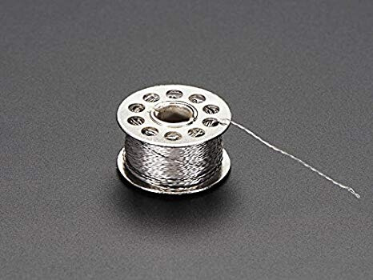
CONDUCTIVE
THREAD
@elginskye

Slide 12
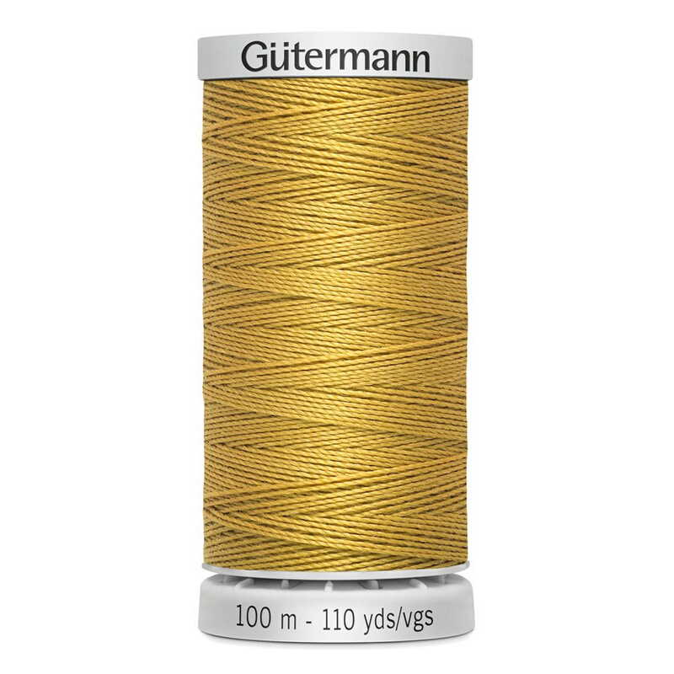
BORING OLD
THREAD
@elginskye

Slide 13
BORING OLD
THREAD
@elginskye

Slide 14
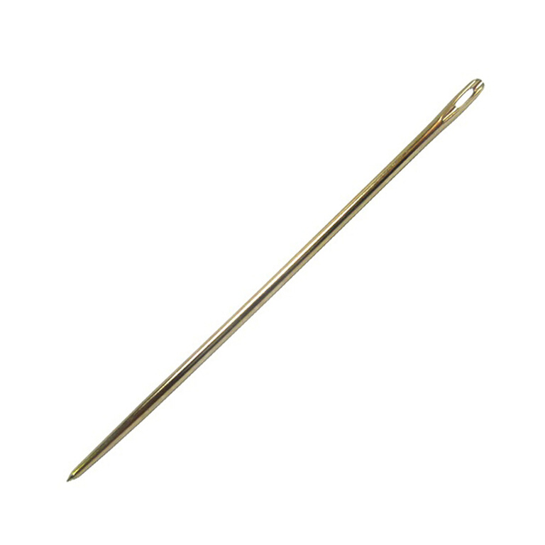
NEEDLES
(Watch out!)
@elginskye

Slide 15
USB CABLE
Psst.... if you have your own, I'd love to use the extras for a future workshop!
@elginskye

Slide 16
MICROBLOCKS
@elginskye

Slide 17
MICROBLOCKS
http://microblocks.fun/
@elginskye

Slide 18
MICROBLOCKS
Visual Programming Language
Easy to set up
Interfaces with WebThings Gateway
@elginskye

Slide 19
MICROBLOCKS
Download
Demo turn on/off LED
Logic
Neopixel Library
Webhings Library
@elginskye

Slide 20
MOZILLA WEBTHINGS
@elginskye

Slide 21
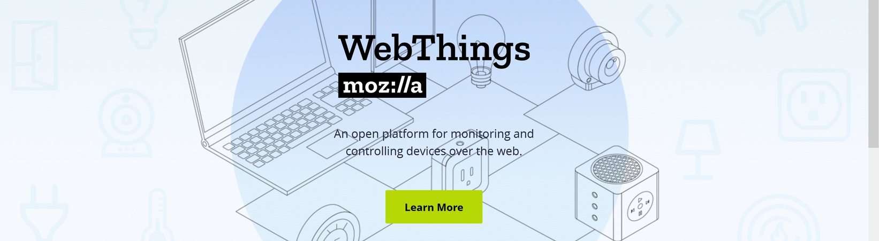
WEBTHINGS
@elginskye

Slide 22
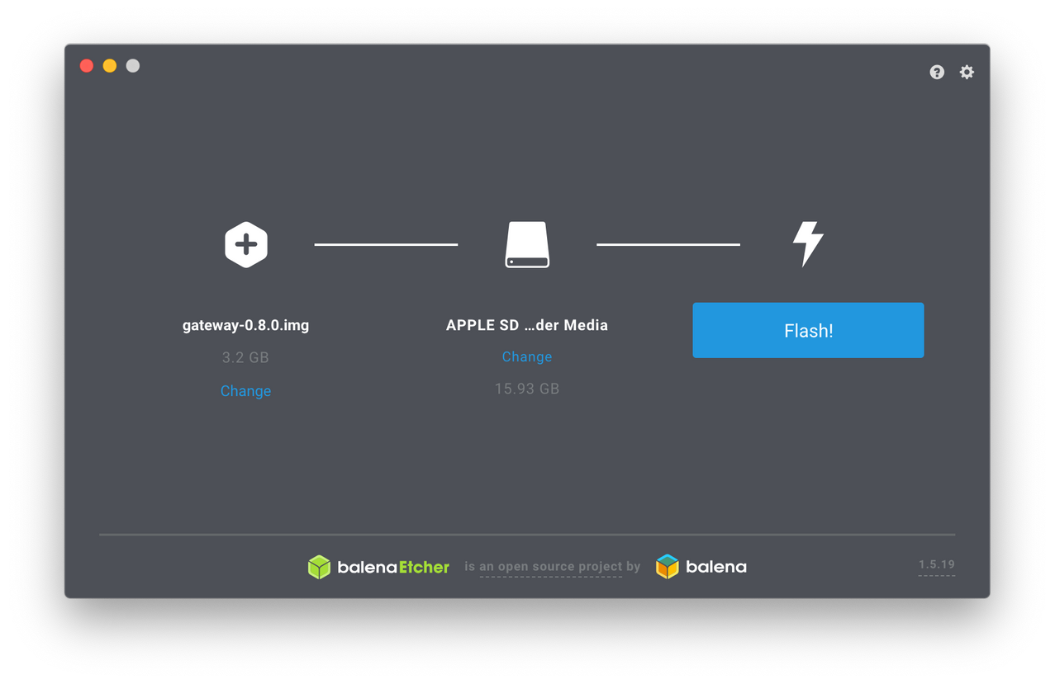
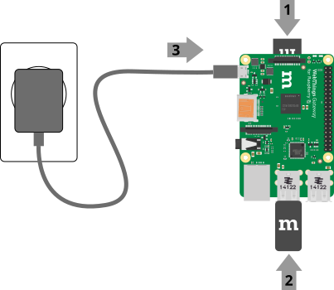
WEBTHINGS
@elginskye

Slide 23
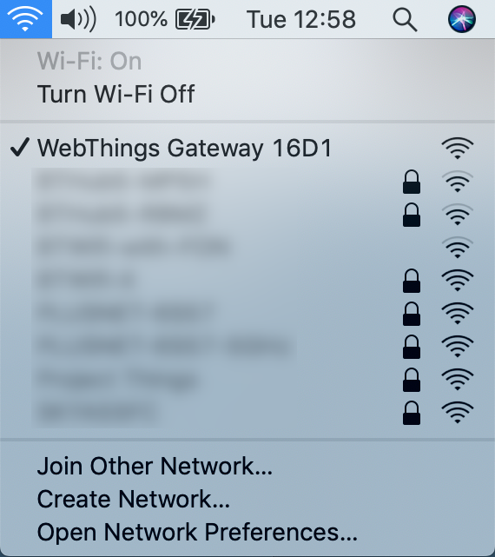
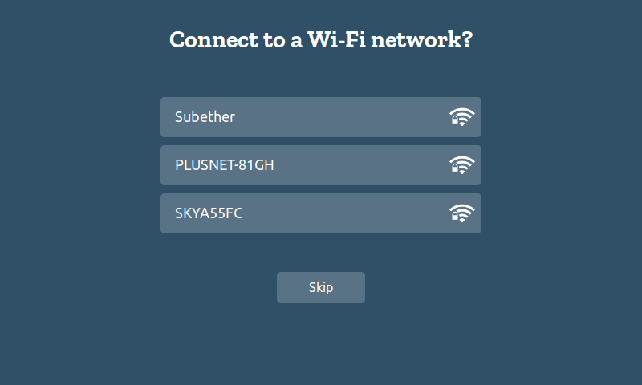
WEBTHINGS
@elginskye

Slide 24
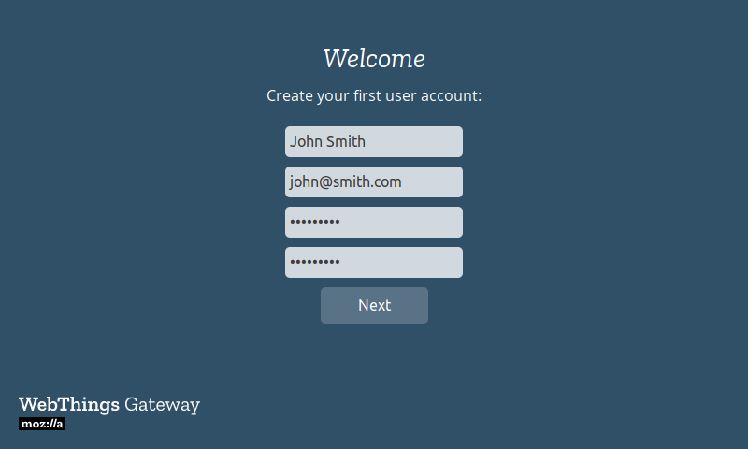
WEBTHINGS
@elginskye

Slide 25
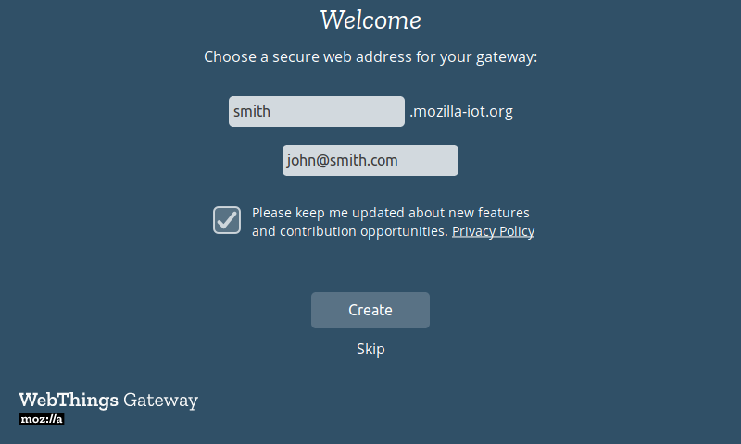
WEBTHINGS
@elginskye

Slide 26
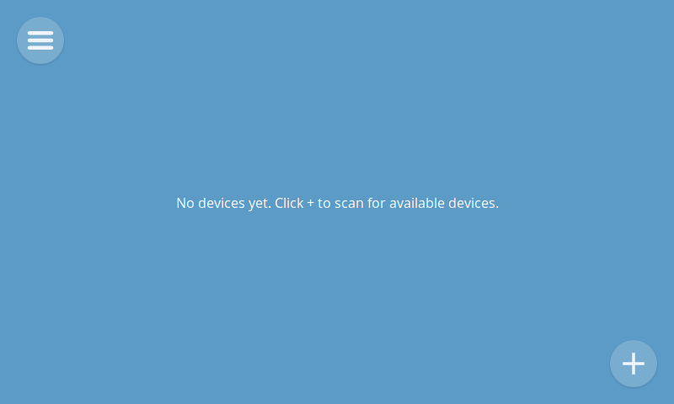
WEBTHINGS
@elginskye

Slide 27
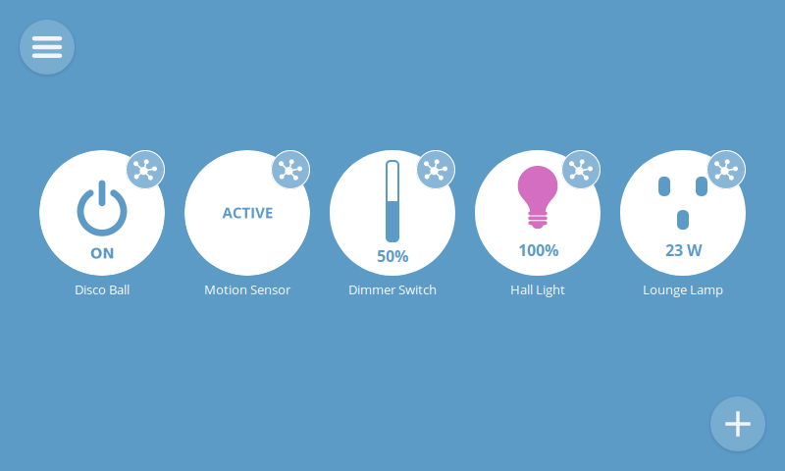
WEBTHINGS
@elginskye

Slide 28
SEWING TIME
@elginskye

Slide 29
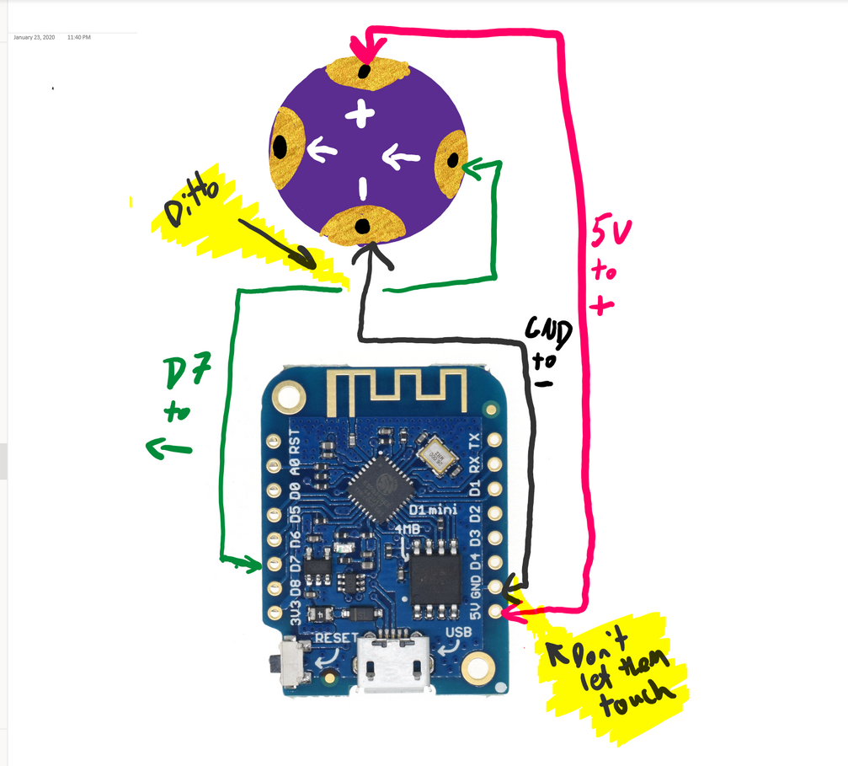
SEWING
@elginskye

Slide 30
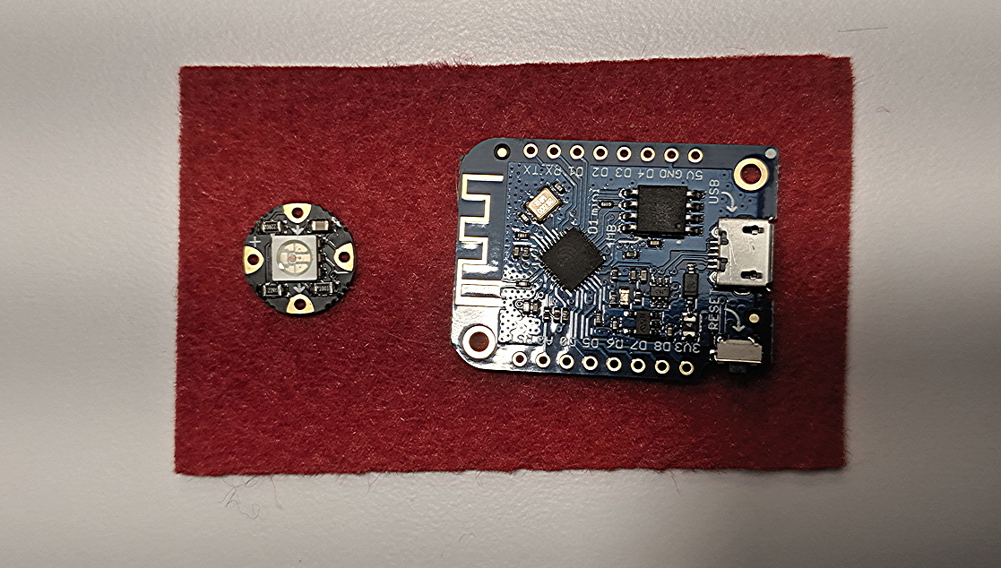
SEWING
Start by cutting out Felt
@elginskye

Slide 31
SEWING
Next, secure with boring old thread in the corners
@elginskye

Slide 32
SEWING
Double check - are you unplugged?
@elginskye

Slide 33
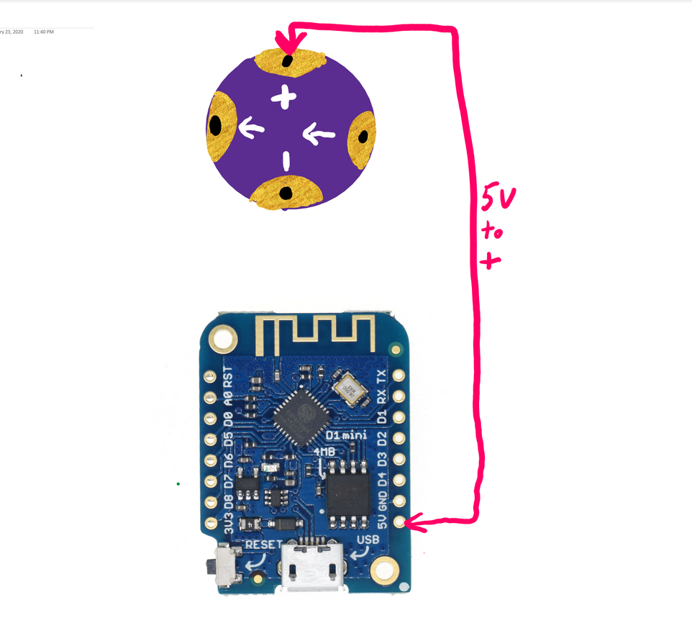
SEWING
Connect where it says 5V to the + sign on the NeoPixel
@elginskye

Slide 34
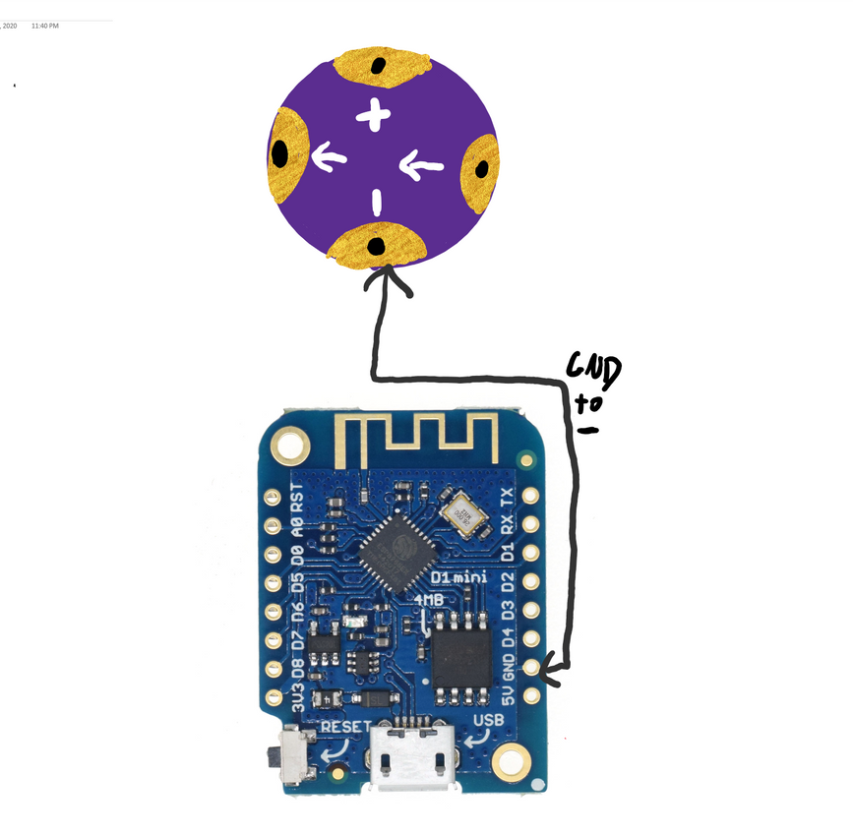
SEWING
Connect where it says GND to the - sign on the NeoPixel
@elginskye

Slide 35
SEWING
Do not let these touch
@elginskye

Slide 36
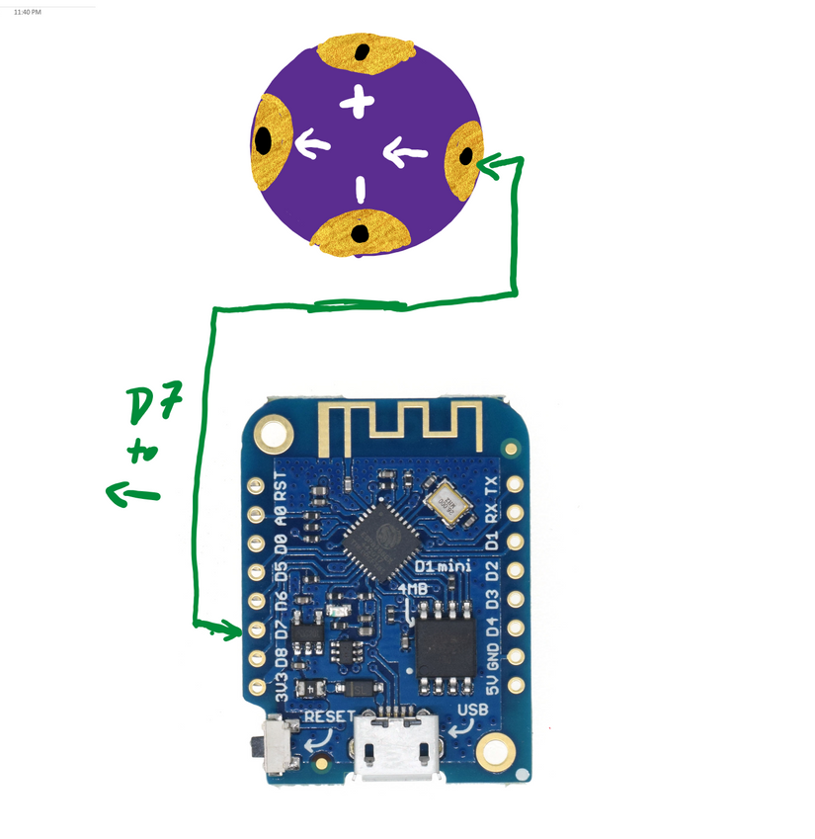
SEWING
Connect pin 13 (AKA D7) to the arrow pointing towards the LED
@elginskye

Slide 37
SEWING
Use hot glue to secure the ends
@elginskye

Slide 38
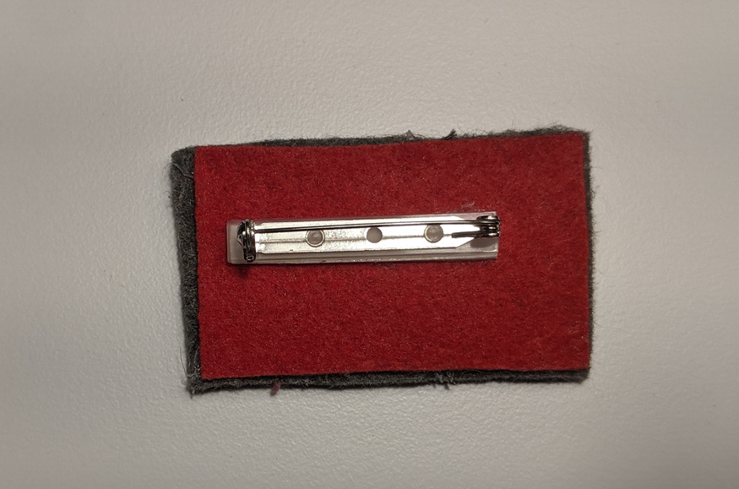
SEWING
Add another layer of felt, and add a backing
@elginskye

Slide 39
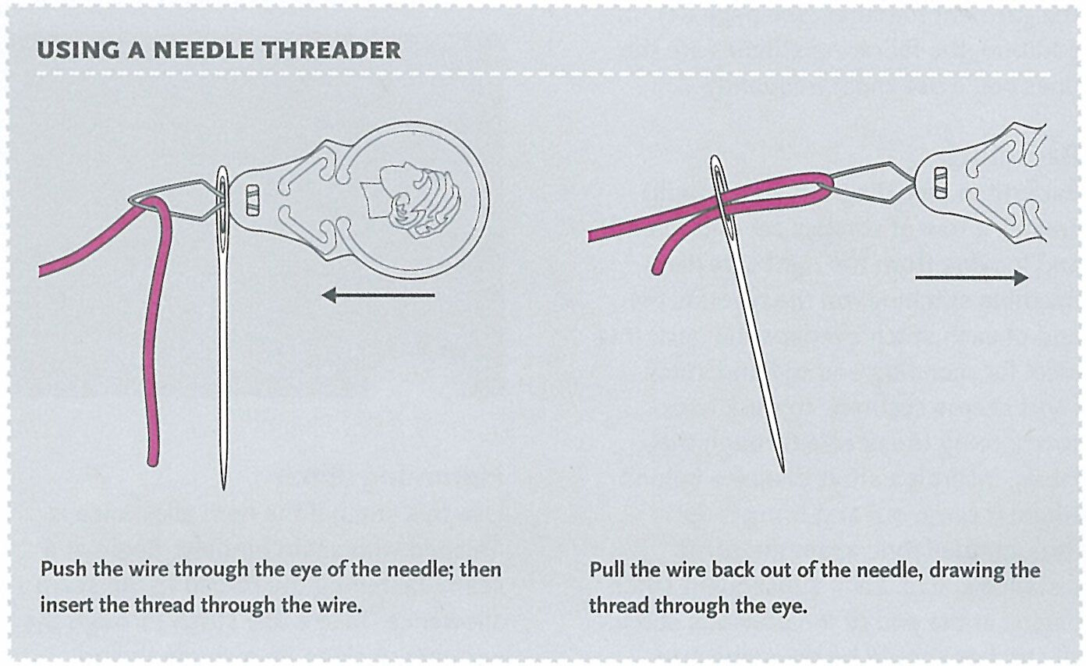
SEWING
@elginskye

Slide 40
SEWING
https://www.youtube.com/watch?v=PowkA9Bojlo
@elginskye

Slide 41
THANK YOU!
STAY IN TOUCH
elginskye@gmail.com
twitter @elginskye

